Slide 1
Run Rin Run
0110714 王秋玄
0116062 許筑淨
0116057 曾亮齊

Slide 2
Overview
Introduction
Game System Architecture
Technical Session
Game Play Demo

Slide 3
Introduction
Game Engine
Ogre3D
Development Environment
Windows 10 (64-bit)
Visual Studio 2010

Slide 4
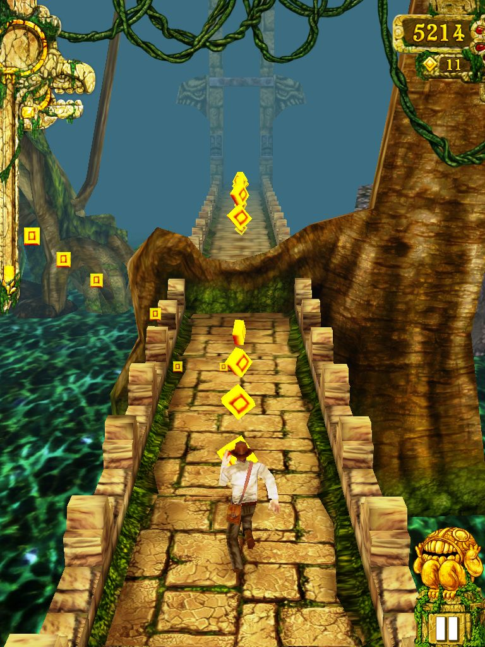
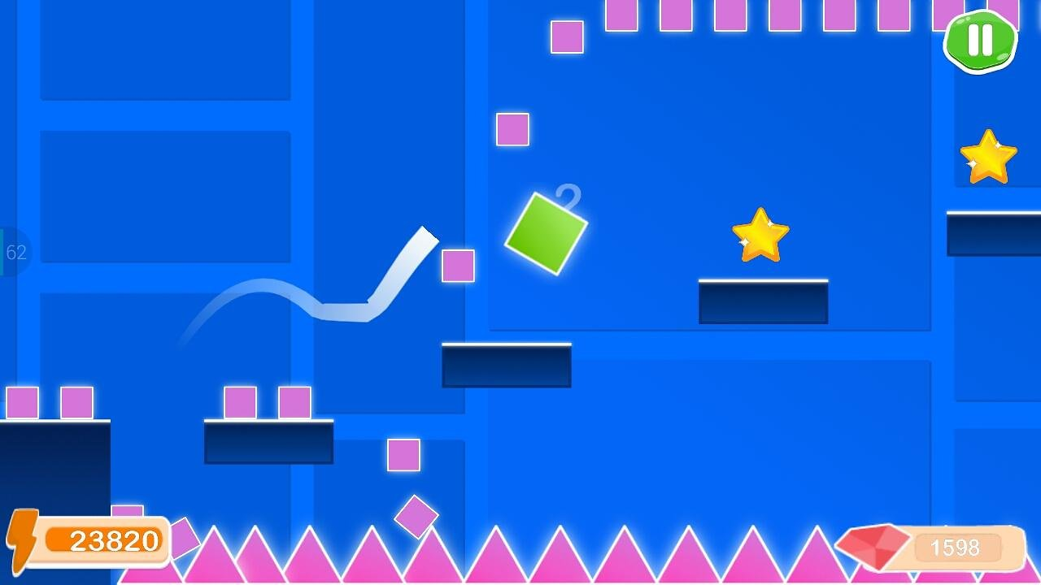
Introduction
Game Type
Obstacle-avoidance
Similar games: temple run, geometry run

Slide 5
Introduction
Goal
Reach the destination with bump into obstacles
Control your character using keyboard
Z : Slide down
X/C : Shoot red/blue bullet
Space: Jump

Slide 6
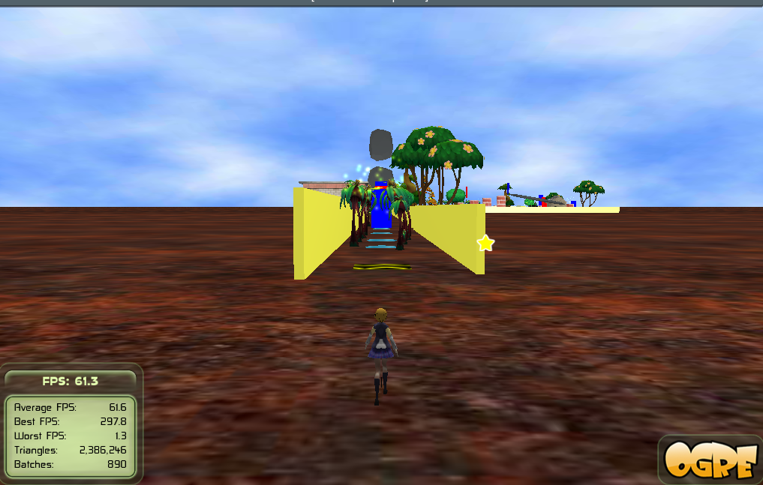

Slide 7
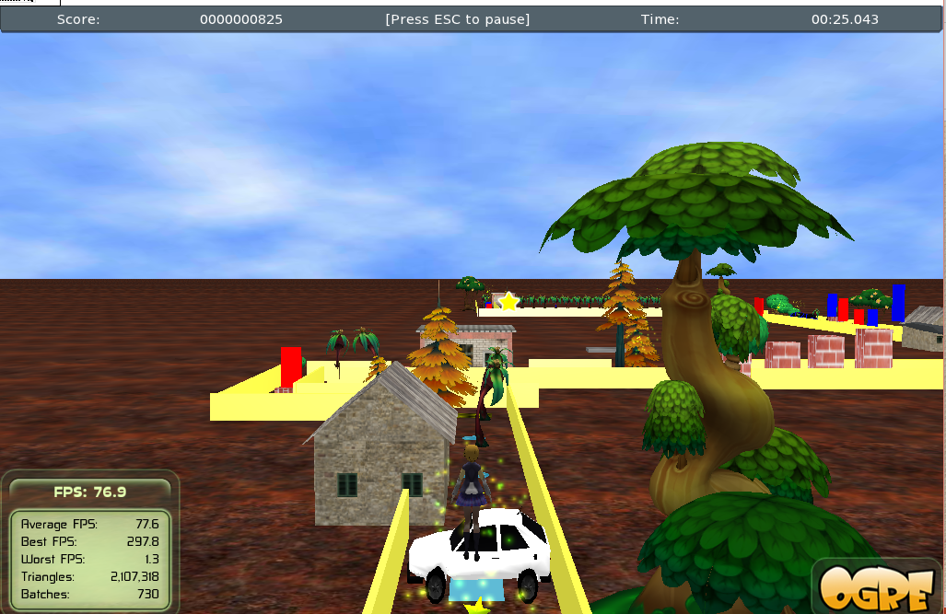

Slide 8
Game Story
In this game, the player will have the chance to help our lovely heroine, Rin cross through everything that hinders her on her way to school.
If the player successfully helps Rin not to be late for school, Rin maybe fall in love with our player.

Slide 9
Work load distribution
王秋玄
Keyboard library, 3D model for characters
許筑淨
Camera control, Game level design, GUI design and 2D picture design
曾亮齊
Physical Engine, DotSceneLoader, GUI engine, Sound library

Slide 10
Game System Architecture
Application (Game logic)
Scene loader
Obstacle system (Physics engine)
Keyboard input system
GUI system
Sound control
Camera control

Slide 11
Game System Architecture - Application
Manage other subsystem
Pass arguments to subsystem
E.g. Keyboard input system
Game Logic
Menu flow control
Judge game over
Score control

Slide 12
Game Logic - Menu flow control
Select Level
Over Menu
Select Level
Select a Level
or Cancel
Back to Menu
Die
Playing Game
Main
Menu
Play
Resume
Press ESC
Back to Menu
Game Menu

Slide 13
Game Logic - Judge game over
On every frameStarted
Setup handler (Who will collide?)
Simulate physics world
Check every pair
Inform application

Slide 14
Game Logic - Score control
On every frameStarted
Check status of player
Jumping, sliding…
Add score according to game time
Check pickup and obstacle destroy
Update GUI

Slide 15
Game System Architecture - Scene Loader
Load .scene files from disk
Depends on which level is playing
Parse the .scene file
Create game objects
Reset scene
When restart game, we should restore everything

Slide 16
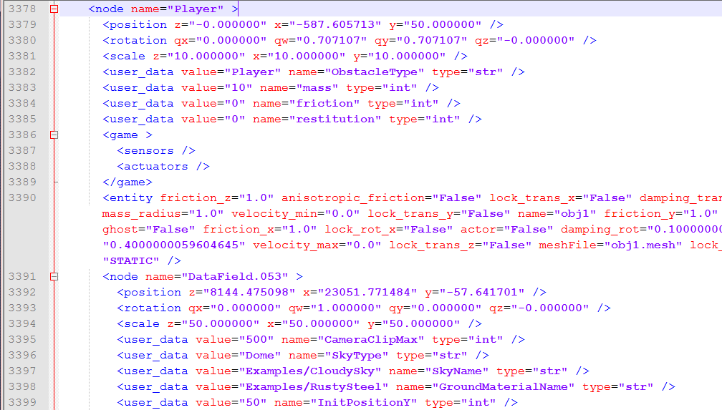

Slide 17
Game System Architecture - Obstacle System
Physical Engine
Use Bullet & OgreBullet library internally
Collision detection
Provides APIs for Scene loader to create game object
createPlayer
createFloor
createBullet
createObstacle

Slide 18
Game System Architecture - Keyboard Input System
Handle variety of keyboard events
Key Pressed
Key Released
Key Triggered
Key Long Pressed
Provides extended APIs for Application

Slide 19
Game System Architecture - GUI System
Create and manage GUI windows
Use CEGUI library internally
No logic code here
Application provides handlers to GUI system
Start/Pause/Restart Game
Select Level
Editor: CEED

Slide 20
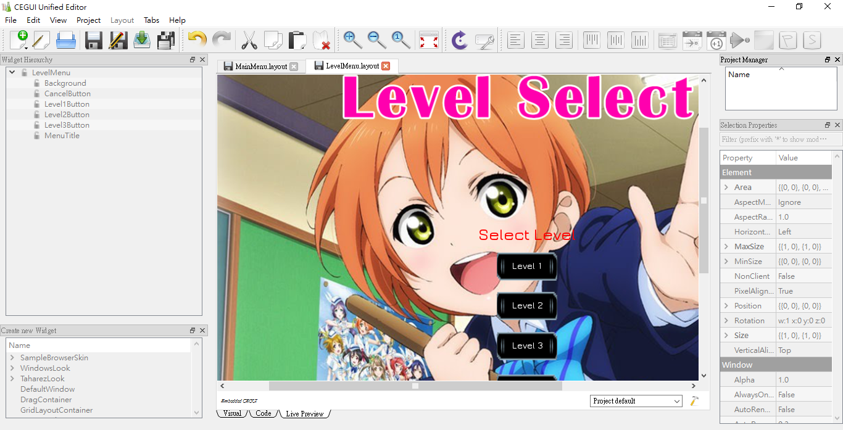

Slide 21
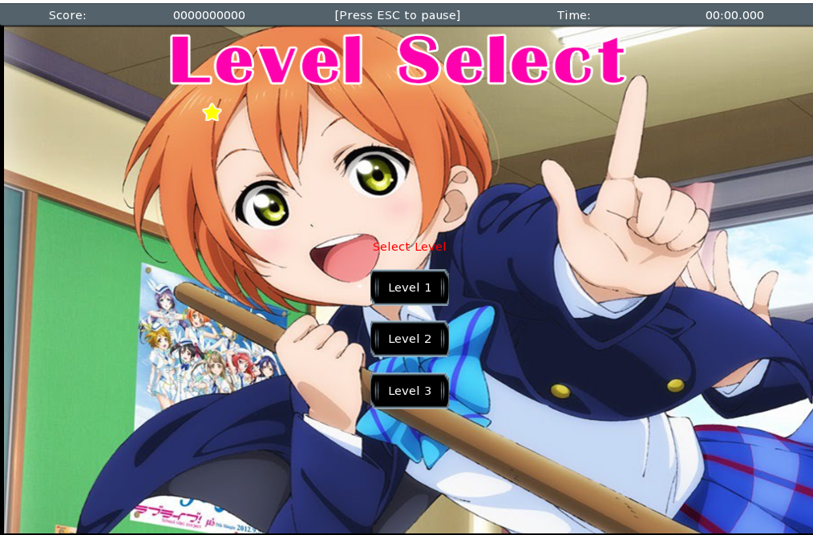
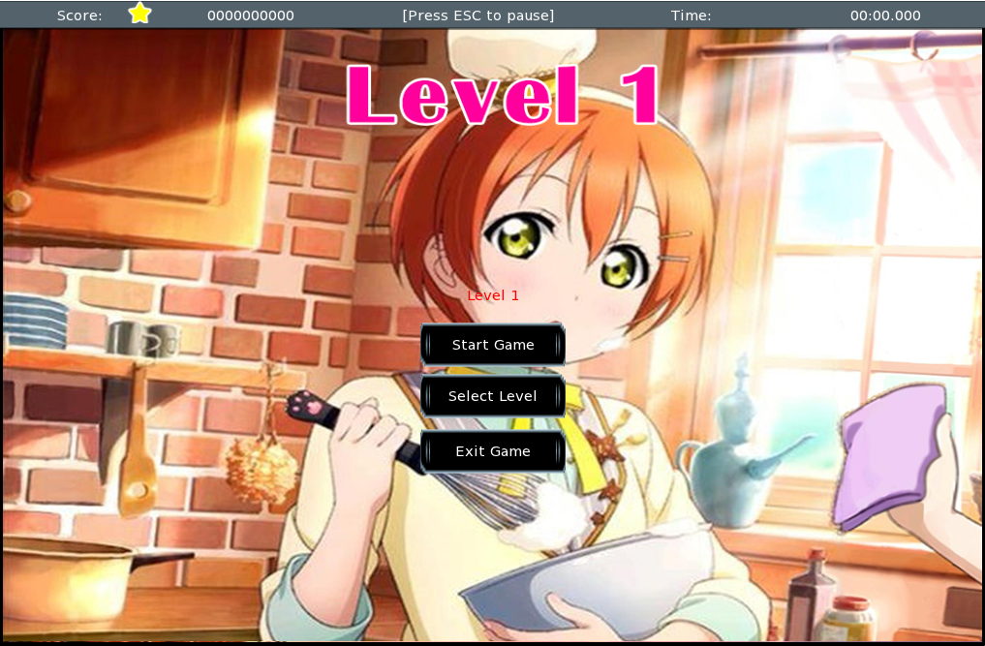
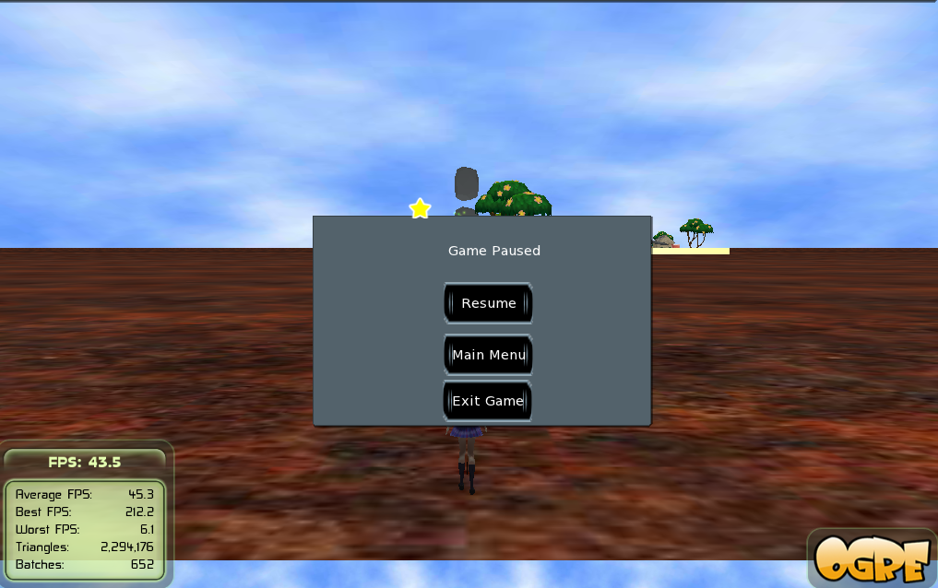
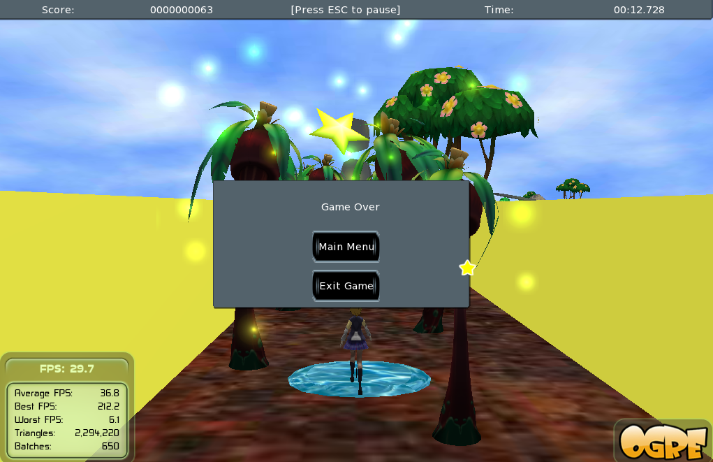

Slide 26
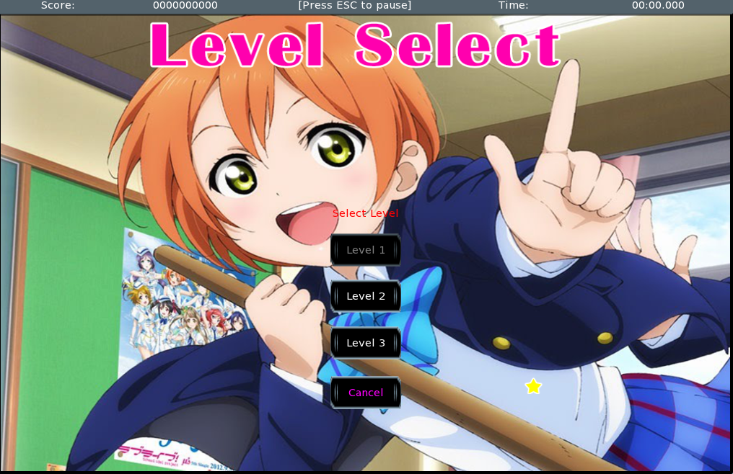

Slide 27
Game System Architecture - Sound Control
Implement using OpenAL
Manage audio source and free unused one
Provides audio APIs for other subsystems
playSE
playBGM
stopBGM
resumeBGM

Slide 28
Game System Architecture - Camera Control
Camera following
Camera rotation
When player change the direction
Smooth motion
Clipping distance control
Previous obstacles should not appear

Slide 29
Technical Session
Level Design
Model Animation
Obstacle System

Slide 30
Technical Session Level Design
External Tool: Blender
Obstacle Property
Attach extra field
Mass, friction, …
Export to Ogre3D

Slide 31
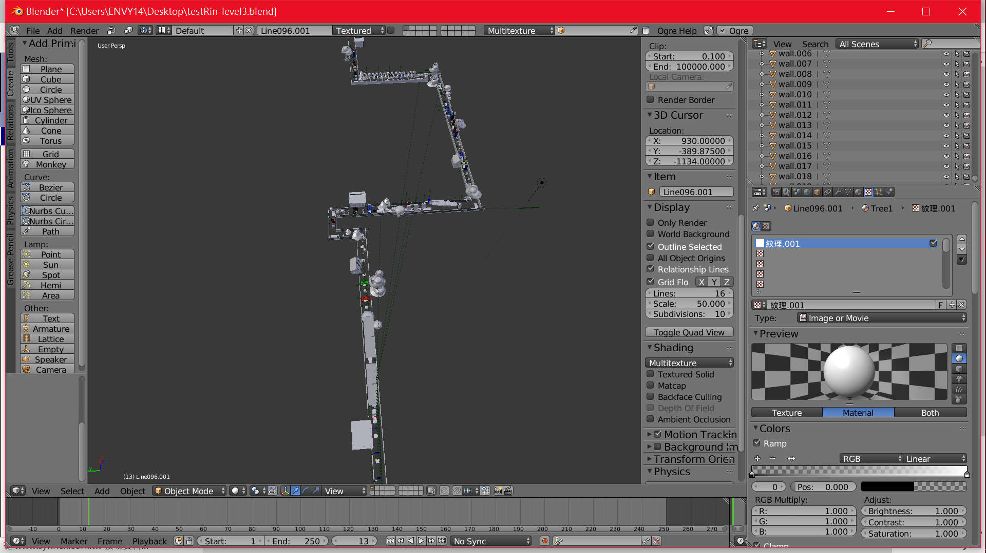

Slide 32
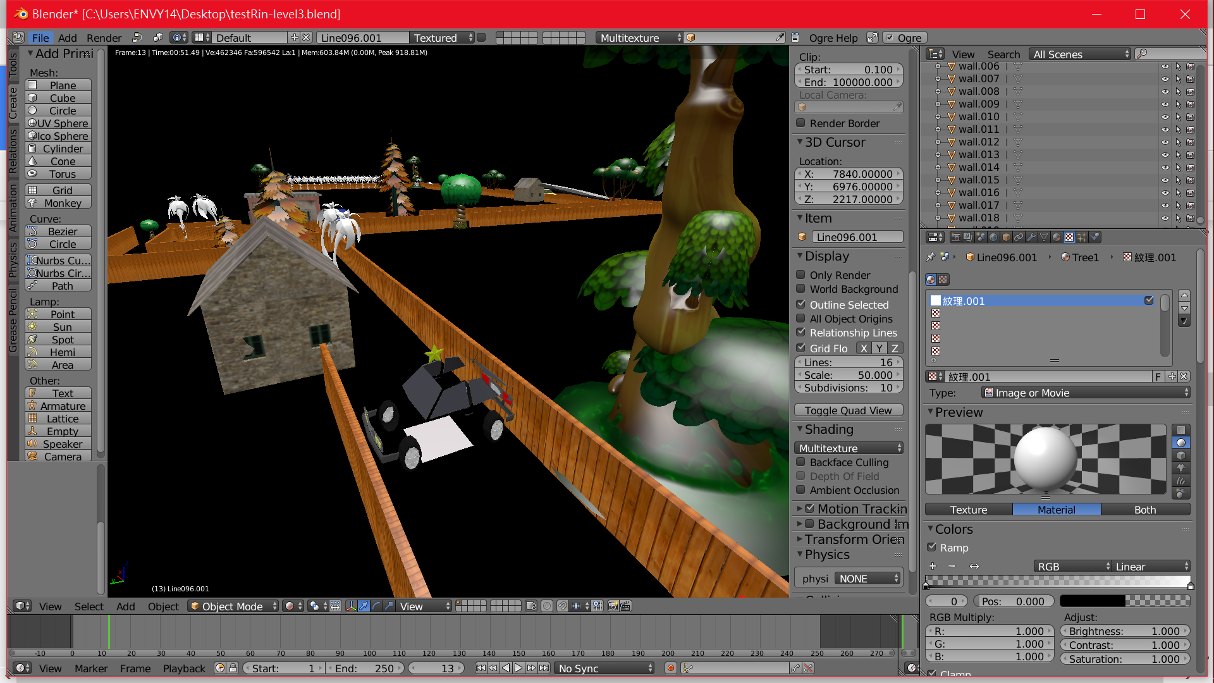

Slide 33
Technical Session Model Animation
Player character should have animation
Create skeleton information for models

Slide 34
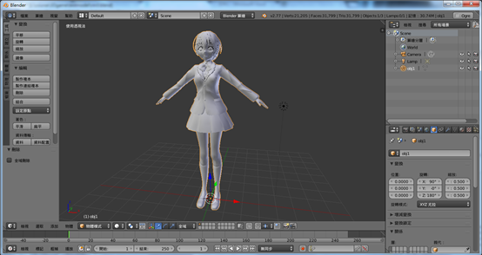

Slide 35
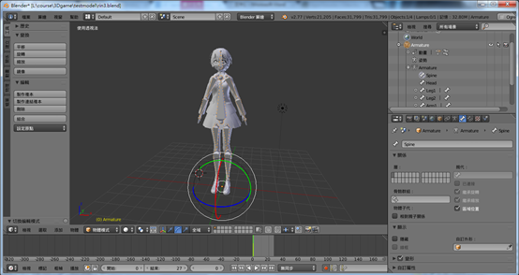

Slide 36
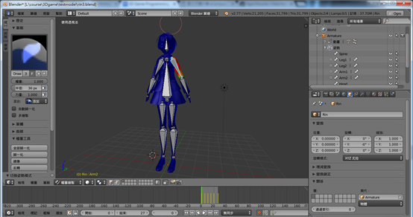

Slide 37
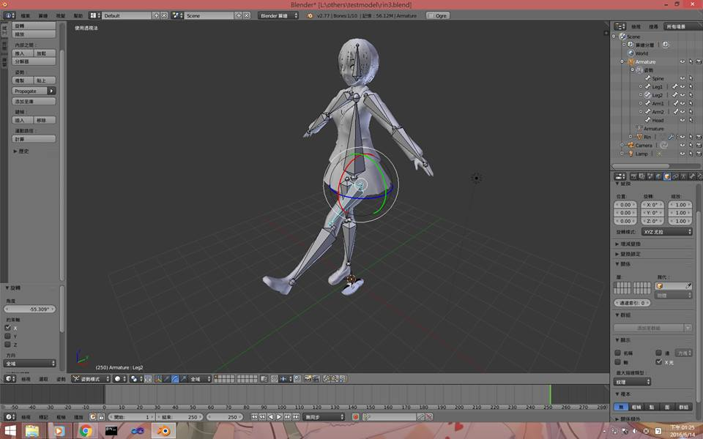

Slide 38
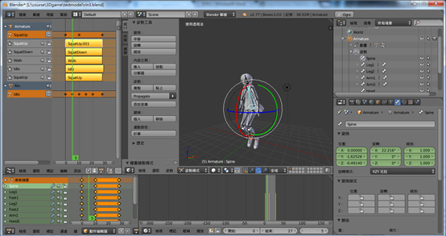

Slide 39
Technical Session Obstacle System
Integrates the Bullet world and Ogre3D world
Synchronize position and orientation
Check and handle collision events
Create and manage obstacle objects

Slide 40
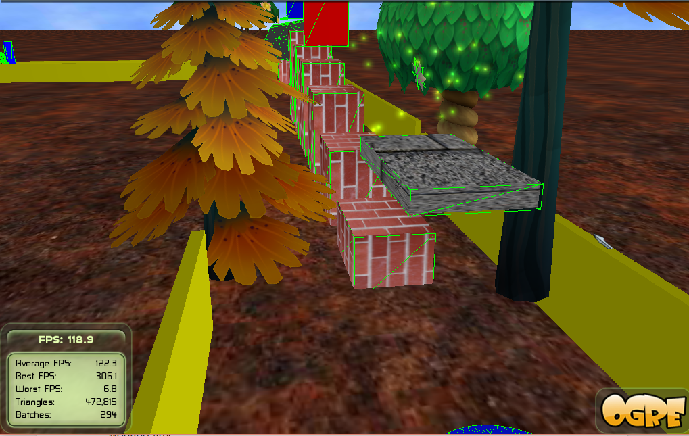

Slide 41
Game Play Demo
3 Levels
Hard
Very Hard
Extremely Hard
God mode
Will not show game over when bump into obstacles
Toggle this mode: F11

Slide 42
The End
Thanks for your listening!

